Slide 1
Web Development & Design Foundations with HTML5 8th Edition, Global Edition
Chapter 4 Key Concepts

Slide 2
Learning Outcomes
In this chapter, you will learn how to . . .
Describe the evolution of style sheets from print media to the Web
List advantages of using Cascading Style Sheets
Use color on web pages
Create style sheets that configure common color and text properties
Apply inline styles
Use embedded style sheets
Use external style sheets
Configure element, class, id, and contextual selectors
Utilize the “cascade” in CSS
Validate CSS

Slide 3
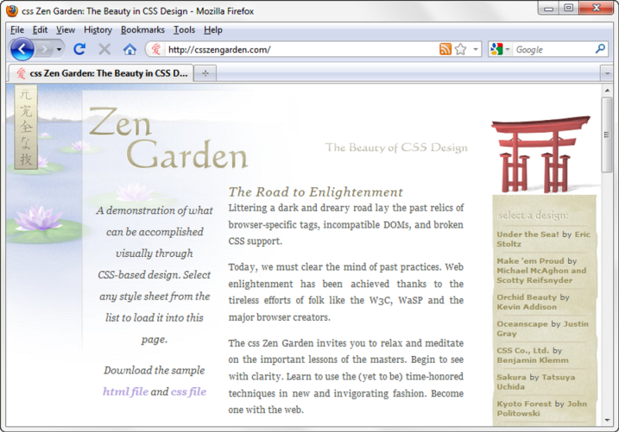
Overview of Cascading Style Sheets (CSS)
See what is possible with CSS:
Visit http://www.csszengarden.com
Style Sheets
used for years in Desktop Publishing
apply typographical styles and spacing to printed media
CSS
provides the functionality of style sheets (and much more) for web developers
a flexible, cross-platform, standards-based language developed by the W3C.

Slide 4
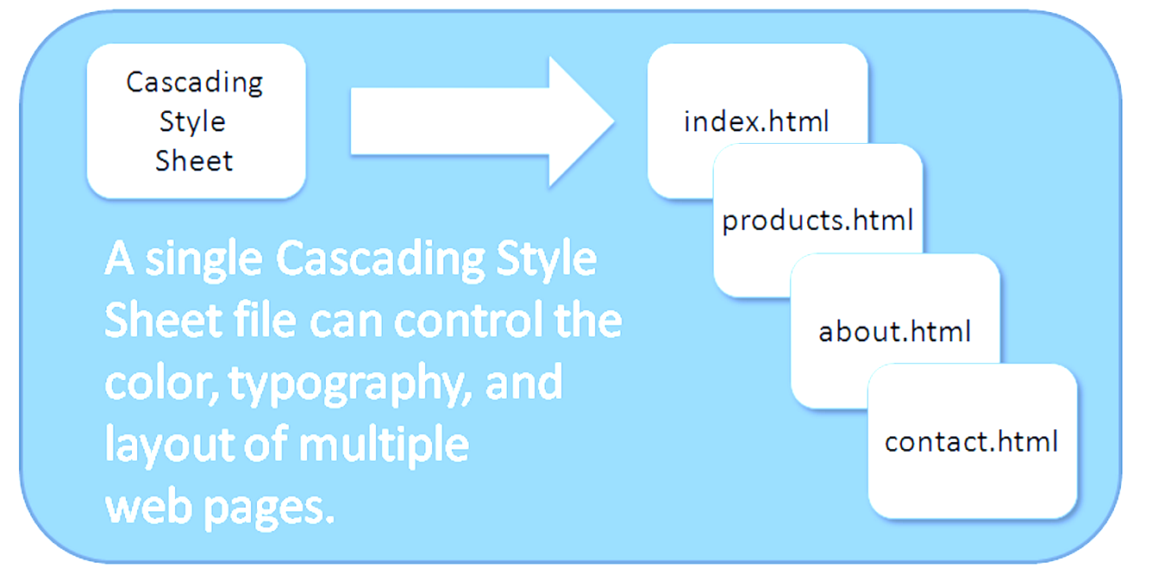
CSS Advantages
Greater typography and page layout control
Style is separate from structure
Styles can be stored in a separate document and associated with the web page
Potentially smaller documents
Easier site maintenance

Slide 5
What is Typography in Web Design?
In web design, typography is implemented using CSS (Cascading Style Sheets). Key CSS properties for typography include:
font-family: Specifies the typeface.
font-size: Sets the size of the text.
line-height: Controls the spacing between lines.
letter-spacing: Adjusts the space between characters.
text-align: Aligns text (left, right, center, justify).
font-weight: Sets the thickness of the text (e.g., bold, normal).

Slide 6
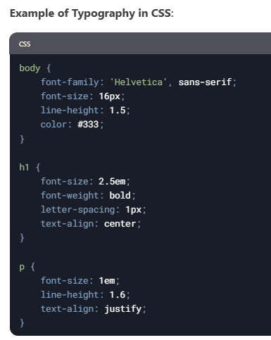

Slide 7
Types of Cascading Style Sheets (1)
Inline Styles
Embedded Styles
External Styles
Imported Styles

Slide 8
Cascading Style Sheets
Inline Styles
body section
HTML style attribute
apply only to the specific element
Embedded Styles
head section
HTML style element
apply to the entire web page document
External Styles
Separate text file with .css file extension
Associate with a HTML link element in the head section of a web page
Imported Styles
Similar to External Styles
We’ll concentrate on the other three types of styles.

Slide 9
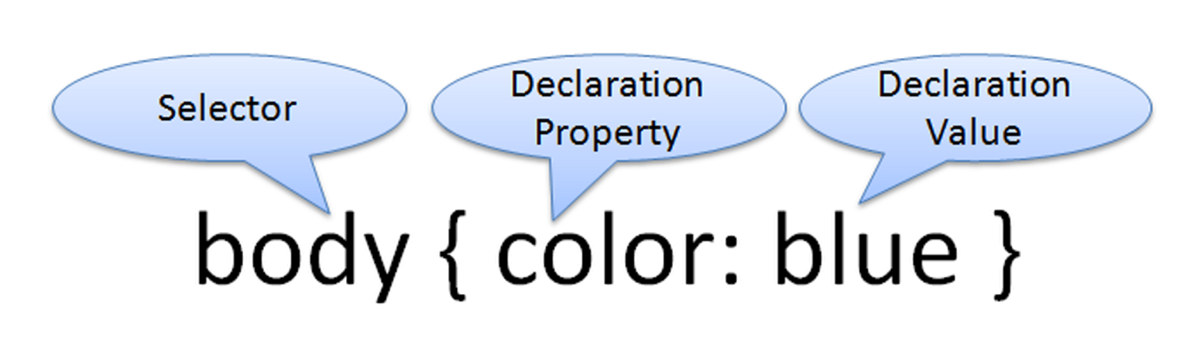
CSS Syntax
Style sheets are composed of "Rules" that describe the styling to be applied.
Each Rule contains a Selector and a Declaration

Slide 10

CSS Syntax Sample
Configure a web page to display blue text and yellow background.
body { color: blue;
background-color: yellow; }
This could also be written using hexadecimal color values as shown below.
body { color: #0000FF;
background-color: #FFFF00; }

Slide 11
Common Formatting CSS Properties
See Table 3.1 Common CSS Properties, including:
background-color
color
font-family
font-size
font-style
font-weight
line-height
margin
text-align
text-decoration
width

Slide 12
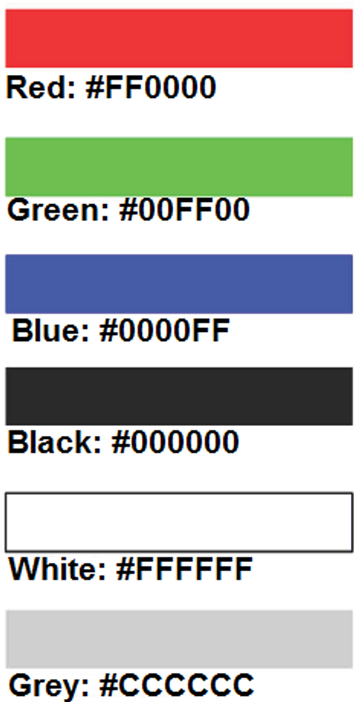
Using Color on Web Pages
Computer monitors display color as intensities of red, green, and blue light
RGB Color
The values of red, green, and blue vary from 0 to 255.
Hexadecimal numbers (base 16) represent these color values.

Slide 13
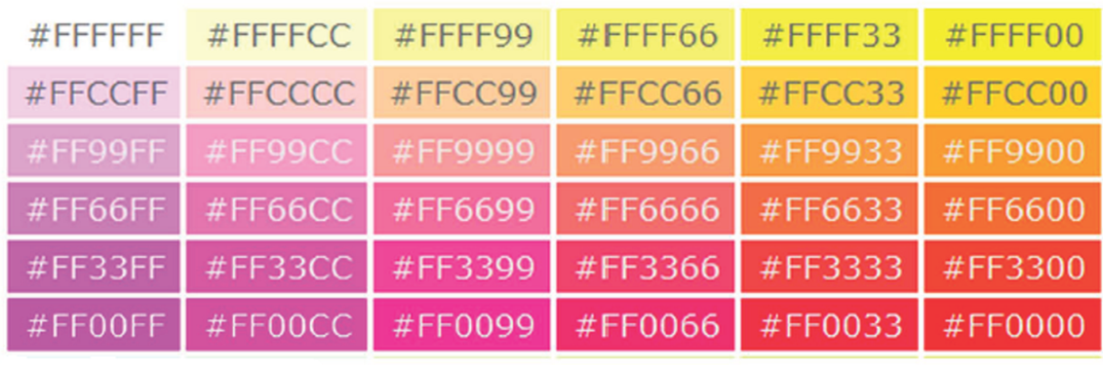
Hexadecimal Color Values
# is used to indicate a hexadecimal value
Hex value pairs range from 00 to FF
Three hex value pairs describe an RGB color
#000000 black #FFFFFF white
#FF0000 red #00FF00 green
#0000FF blue #CCCCCC grey

Slide 14
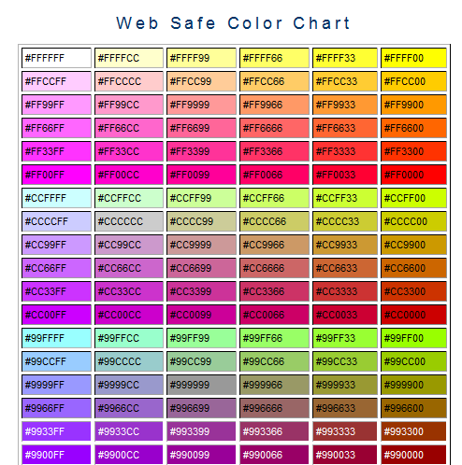
Web Color Palette
A collection of 216 colors
Display the most similar on the Mac and PC platforms
Hex values: 00, 33, 66, 99, CC, FF
Color Chart http://webdevfoundations.net/color

Slide 15
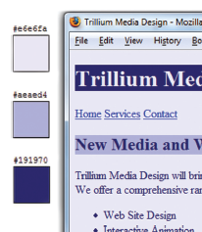
Making Color Choices
How to choose a color scheme?
Monochromatic
http://meyerweb.com/eric/tools/color-blend
Choose from a photograph or other image
http://www.colr.org
Begin with a favorite color
Use one of the sites below to choose other colors
http://colorsontheweb.com/colorwizard.asp
http://kuler.Adobe.com
http://colorschemedesigner.com/

Slide 16
Verify Sufficient Contrast
When you choose colors for text and background, sufficient contrast is needed so that the text is easy to read.
Use one of the following online tools to verify contrast:
http://webaim.org/resources/contrastchecker/
http://snook.ca/technical/colour_contrast/colour.html
http://juicystudio.com/services/luminositycontrastratio.php
Web Content Accessibility Guidelines (WCAG) international standard

Slide 17

Inline styles
Inline styles refer to the practice of applying CSS (Cascading Style Sheets) directly within an HTML element using the style attribute.
This allows you to define styles for a specific element without using an external stylesheet or a <style> block in the <head> of the document.
Syntax of Inline Styles
Inline styles are added to an HTML element using the style attribute. The value of the style attribute is a series of CSS property-value pairs, separated by semicolons (;).
Example:

Slide 18
Example of Inline Styles in a Real-World Scenario
<html>
<div style="background-color: #f4f4f4; padding: 20px; border-radius: 8px;">
<h1 style="color: #333; font-size: 24px; margin-bottom: 10px;">
Welcome to My Website
</h1>
<p style="color: #666; font-size: 16px; line-height: 1.5;">
This is an example of inline styles in action.
</p>
<button style="background-color: #007bff; color: #fff; padding: 10px 20px; border: none; border-radius: 4px;">
Click Me
</button>
</div>
</html>

Slide 19
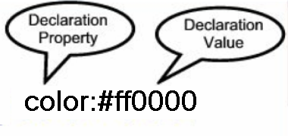

Configuring Color with Inline CSS
Inline CSS
Configured in the body of the web page
Use the style attribute of an HTML tag
Apply only to the specific element
The Style Attribute
Value: one or more style declaration property and value pairs
Example: configure red color text in an <h1> element:
<h1 style="color:#ff0000">Heading text is red</h1>

Slide 20
Configuring Color with Inline CSS
Example 2: configure the red text in the heading
configure a gray background in the heading
Separate style rule declarations with ;
<h1 style="color:#FF0000;background-color:#cccccc">This is displayed as a red heading with gray background</h1>

Slide 21
CSS Embedded (Internal) Styles
An embedded style sheet (also known as an internal style sheet) is a block of CSS code that is placed directly within an HTML document, typically inside the <style> element in the <head> section.
Unlike an external style sheet (which is linked via a separate .css file), an embedded style sheet applies only to the HTML document in which it is defined.
Key Characteristics of Embedded Style Sheets:
Scope: The styles defined in an embedded style sheet apply only to the current HTML document.
Placement: It is placed within the <style> tag, which is usually located inside the <head> section of the HTML document.
Specificity: Embedded styles have higher priority than external styles (unless !important is used in the external styles), but lower priority than inline styles (styles applied directly to an element using the style attribute).

Slide 22
<!DOCTYPE html>
<html lang="en">
<head>
<meta charset="UTF-8">
<meta name="viewport" content="width=device-width, initial-scale=1.0">
<title>Embedded Style Sheet Example</title>
<style>
/* Embedded CSS goes here */
body {
font-family: Arial, sans-serif;
background-color: #f0f0f0;
}
h1 {
color: blue;
}
p {
color: green;
}
</style>
</head>
<body>
<h1>This is a heading</h1>
<p>This is a paragraph with styles defined in the embedded style sheet.</p>
</body>
</html>

Slide 23
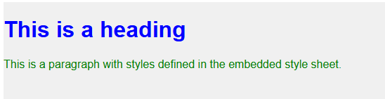

Slide 24
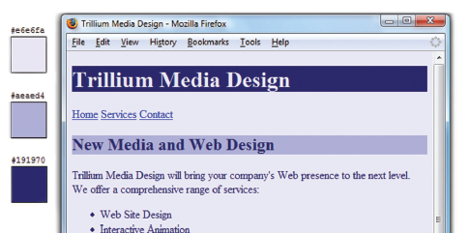
CSS Embedded Styles
The body selector sets the global style rules for the entire page.
These global rules are overridden for <h1> and <h2> elements by the h1 and h2 style rules.
<style>
body { background-color: #E6E6FA;
color: #191970;}
h1 { background-color: #191970;
color: #E6E6FA;}
h2 { background-color: #AEAED4;
color: #191970;}
</style>

Slide 25
Checkpoint 3.1
List three reasons to use CSS on a web page.
When designing a page that uses colors other than the default colors for text and background, explain why it is a good reason to configure style rules for both text color and background color.
Describe one advantage to using embedded styles instead of inline styles.

Slide 26
Configuring Text with CSS
CSS properties for configuring text:
font-weight
Configures the boldness of text
font-style
Configures text to an italic style
font-size
Configures the size of the text
font-family
Configures the font typeface of the text

Slide 27
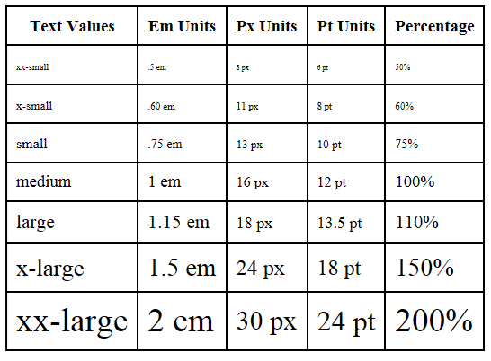
The font-size Property
Accessibility Recommendation: Use em or percentage font sizes – these can be easily enlarged in all browsers by users

Slide 28
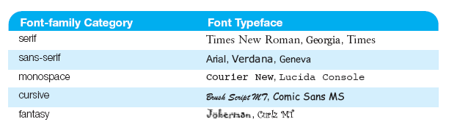
The font-family Property
Not everyone has the same fonts installed in their computer
Configure a list of fonts and include a generic family name
p { font-family: Arial, Verdana, sans-serif; }

Slide 29

Embedded Styles Example
<style>
body { background-color: #E6E6FA;
color: #191970;
font-family: Arial, Verdana, sans-serif; }
h1 { background-color: #191970;
color: #E6E6FA;
line-height: 200%;
font-family: Georgia, "Times New Roman", serif; }
h2 { background-color: #AEAED4;
color: #191970; text-align: center;
font-family: Georgia, "Times New Roman", serif; }
p {font-size: .90em; text-indent: 3em; }
ul {font-weight: bold; }
</style>

Slide 30
More CSS TEXT Properties
line-height
Configures the height of the line of text (use the value 200% to appear double-spaced)
text-align
Configures alignment of text within a block display element
text-indent
Configures the indentation of the first line of text
text-decoration
Modifies the appearance of text with an underline, overline, or line-through
text-transform
Configures the capitalization of text
text-shadow
Configures a drop shadow on text

Slide 31
When to Use Embedded Style Sheets:
Single-Page Websites: If you're working on a small project or a single-page website, an embedded style sheet can be convenient because it keeps everything in one file.
Quick Prototyping: For testing or prototyping, embedded styles are faster to implement than linking an external CSS file.
Page-Specific Styles: If a particular HTML page requires unique styles that aren't used elsewhere, an embedded style sheet can be a good choice.
Advantages of Embedded Style Sheets:
Self-Contained: All styles are contained within the HTML file, making it easier to manage for small projects.
No Additional HTTP Requests: Unlike external style sheets, embedded styles don't require an additional HTTP request to load a separate file.
Ease of Use: Quick to implement for small-scale projects or quick fixes.

Slide 32
CSS selectors
What Are CSS Selectors?
CSS selectors are patterns used to select and style HTML elements
Essential for creating dynamic and responsive web designs.
They are a fundamental part of CSS and allow you to target specific elements or groups of elements to apply styles.
Here's a comprehensive overview of the most common and useful CSS selectors:
Basic Selectors
Element Selector: Syntax: element Example: p { color: blue; }
Class Selector: Syntax: .classname
Example: .highlight { background-color: yellow; }
ID Selector: Syntax: #idname Example: #header { font-size: 24px; }
Universal Selector: Syntax: * Example: * { margin: 0; padding: 0; }

Slide 33
2. Attribute Selectors
Attribute Presence: Syntax: [attribute] Example: [target] { border: 1px solid black; }
Attribute Value: Syntax: [attribute="value"] Example: [type="submit"] { background-color: green; }
Attribute Contains: Syntax: [attribute*="value"] Example: [href*="example"] { color: red; }
Attribute Starts With: Syntax: [attribute^="value"] Example: [href^="https"] { color: green; }
Attribute Ends With: Syntax: [attribute$="value"] Example: [href$=".pdf"] { color: blue; }
3. Combinators
Descendant Combinator: Syntax: selector1 selector2 Example: div p { color: red; }
Child Combinator: Syntax: selector1 > selector2 Example: ul > li { list-style-type: square; }
Adjacent Sibling Combinator: Syntax: selector1 + selector2 Example: h1 + p { font-weight: bold; }
General Sibling Combinator: Syntax: selector1 ~ selector2 Example: h1 ~ p { color: blue; }
4. Pseudo-Classes
State-Based: Syntax: selector: pseudo-class Example: a:hover { color: red; }
Position-Based: Syntax: selector: pseudo-class Example: li:first-child { font-weight: bold; }

Slide 34
Pseudo-Elements
Content:
Syntax: selector::pseudo-element
Examples:
p::first-line { font-weight: bold; }
p::before { content: "→ "; }

Slide 35
CSS Selectors
CSS style rules can be configured for an:
HTML element selector
class selector
id selector
descendant selector

Slide 36
Using CSS with “class”
class Selector
Apply a CSS rule to a certain "class" of elements on a web page
Does not associate the style to a specific HTML element
Configure with .classname
code CSS to create a class called “new” with red italic text.
Apply the class:
<p class=“new”>This is text is red and in italics</p>
<style>
.new { color: #FF0000;
font-style: italic;
}
</style>

Slide 37

Using CSS with “id”
id Selector
Apply a CSS rule to ONE element on a web page.
Configure with #idname
Code CSS to create an id called “new” with red, large, italic text.
Apply the id:
<p id=“new”>This is text is red, large, and in italics</p>
<style>
#new { color: #FF0000;
font-size:2em;
font-style: italic;
}
</style>

Slide 38
CSS Descendant Selector
Specify an element within the context of its container (parent) element.
AKA contextual selector
The example configures a green text color only for p tags located within an element assigned to the id named “content”
Advantage of contextual selectors: Reduces the number of classes and ids you need to apply in the HTML
<style>
#content p { color: #00ff00; }
</style>

Slide 39
span element
Purpose:
configure a specially formatted area displayed in-line with other elements, such as within a paragraph.
There is no additional empty space above or below a span – it is inline display.

Slide 40
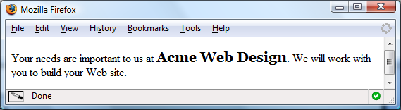
span Element Example
Embedded CSS:
<style>
.companyname { font-weight: bold;
font-family: Georgia, "Times New Roman", serif;
font-size: 1.25em;
}
</style>
HTML:
<p>Your needs are important to us at <span class=“companyname">Acme Web Design</span>. We will work with you to build your Web site.</p>

Slide 41
External Style Sheets - 1
CSS style rules are contained in a text file separate from the HTML documents.
The External Style Sheet text file:
extension ".css"
contains only style rules
does not contain any HTML tags

Slide 42
External Style Sheets - 2
Multiple web pages can associate with the same external style sheet file.
site.css
index.html
body {background-color:#E6E6FA;
color:#000000;
font-family:Arial, sans-serif;
font-size:90%; }
h2 { color: #003366; }
.nav { font-size: 16px;
font-weight: bold; }
clients.html
about.html
Etc…

Slide 43
link Element
A self-contained tag
Placed in the header section
Purpose: associates the external style sheet file with the web page.
Example:
<link rel="stylesheet" href="color.css">

Slide 44
Using an External Style Sheet
External Style Sheet color.css
body { background-color: #0000FF;
color: #FFFFFF;
}
To associate the external style sheet called color.css, the HTML code placed in the head section is: <link rel="stylesheet" href="color.css">

Slide 45
Checkpoint 3.2
1. Describe a reason to use embedded styles. Explain where embedded styles are placed on a web page.
2. Describe a reason to use external styles. Explain where external styles are placed and how web pages indicate they are using external styles.
3. Write the code to configure a web page to use an external style sheet called “mystyles.css”.

Slide 46

Centering Page Content with CSS
#container { margin-left: auto;
margin-right: auto;
width:80%; }

Slide 47
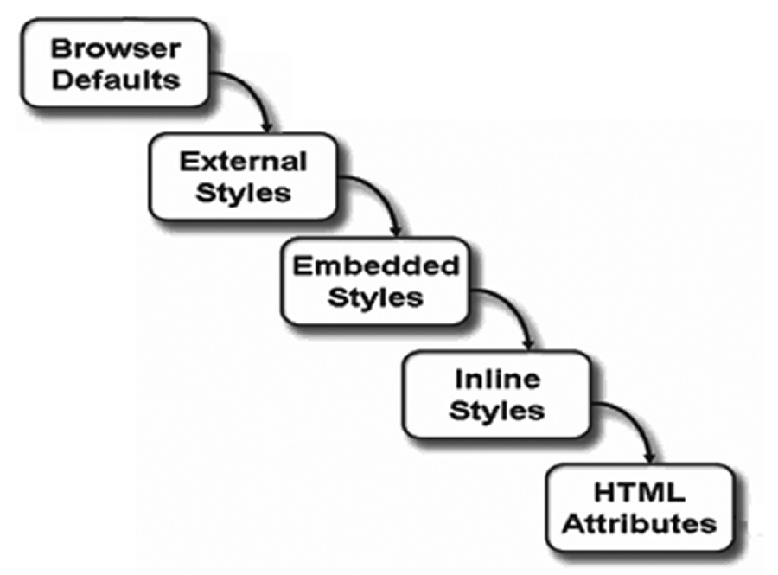
The “Cascade”

Slide 48
Overriding Rules for Different Types of CSS
When working with CSS (Cascading Style Sheets), understanding the rules that determine which styles are applied when multiple rules conflict is crucial. These rules are often referred to as the "cascade" in CSS.
Here are the key overriding rules for different types of CSS:
1. Source Order
Rule: If two rules have the same specificity, the one that appears later in the CSS file takes precedence. For Example:
p { color: red; } p { color: blue; } /* This one will be applied */
2. Specificity
Rule: More specific selectors override less specific ones. Specificity is calculated based on the types of selectors used.
Specificity Hierarchy (from highest to lowest):
Inline styles (e.g., style="color: green;")
ID selectors (e.g., #myElement)
Class selectors, attribute selectors, and pseudo-classes (e.g., .myClass, [type="text"], :hover)
Element selectors and pseudo-elements (e.g., div, ::before)
Example:
#myElement { color: red; } /* This one will be applied */
.myClass { color: blue; }

Slide 49
3. Importance (!important)
Rule: The !important flag overrides all other rules, regardless of specificity or source order. For Example:
p { color: red !important; } /* This one will be applied */
p { color: blue; }
4. Inline Styles
Rule: Inline styles (styles applied directly to an HTML element using the style attribute) have higher specificity than external or internal stylesheets, except when !important is used.
<p style="color: green;">This text is green.</p>
p { color: red; } /* Inline style takes precedence */
5. User Agent Styles
Rule: Browser default styles (user agent styles) have the lowest priority and are overridden by any author-defined styles (external, internal, or inline).
p { color: red; } /* Overrides the browser's default color */

Slide 50
6. Inheritance
Rule: Some CSS properties are inherited by child elements from their parent elements. Inherited styles have lower priority than directly applied styles.
body { color: red; }
p { color: blue; } /* This one will be applied to <p> elements */
7. Media Queries
Rule: Styles within media queries can override other styles based on the conditions specified (e.g., screen width). The specificity and source order still apply within the media query.
p { color: red; }
@media (max-width: 600px) {
p { color: blue; } /* This one will be applied on screens narrower than 600px */
}
8. Scoped Styles
Rule: In some frameworks or with the use of scoped styles (e.g., in Vue.js), styles are scoped to a specific component and may override global styles within that scope.
<style scoped>
p { color: red; } /* This style is scoped to the component */
</style>

Slide 51
Summary of Overriding Rules
(from highest to lowest priority):
!important
Inline styles
ID selectors
Class/attribute/pseudo-class selectors
Element/pseudo-element selectors
Source order (later rules override earlier ones)
Inherited styles

Slide 52
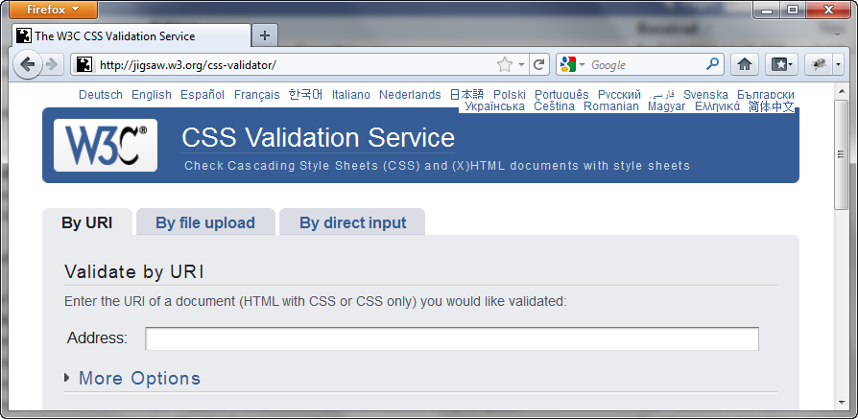
W3C CSS Validation
http://jigsaw.w3.org/css-validator/

Slide 53
To display HTML tags as plaintext in a web page (so that the tags are visible and not interpreted as HTML), you can use one of the following methods:
1. Use <pre> and Escape Special Characters
Replace < with &lt; and > with &gt; to escape the HTML tags.
Wrap the content in <pre> to preserve formatting.
<pre>
&lt;html&gt;
&lt;head&gt;
&lt;title&gt;Example&lt;/title&gt;
&lt;/head&gt;
&lt;body&gt;
&lt;p&gt;This is a paragraph.&lt;/p&gt;
&lt;/body&gt;
&lt;/html&gt;
</pre>
2. Use <code> and Escape Special Characters
Similar to the above, but use <code> for semantic markup.
<code>
&lt;html&gt;
&lt;head&gt;
&lt;title&gt;Example&lt;/title&gt;
&lt;/head&gt;
&lt;body&gt;
&lt;p&gt;This is a paragraph.&lt;/p&gt;
&lt;/body&gt;
&lt;/html&gt;
</code>

Slide 54
3. Use <xmp> (Deprecated but Works)
The <xmp> tag was used in older HTML versions to display HTML tags as plaintext.
It is deprecated but still works in most browsers.
<xmp>
<html>
<head>
<title>Example</title>
</head>
<body>
<p>This is a paragraph.</p>
</body>
</html>
</xmp>
Note: Avoid using <xmp> in production as it is not part of the HTML5 standard.
4. Use JavaScript to Escape HTML
You can dynamically escape HTML tags using JavaScript.
<div id="display-html"></div>
<script>
const htmlContent = `
<html>
<head>
<title>Example</title>
</head>
<body>
<p>This is a paragraph.</p>
</body>
</html>
`;
document.getElementById('display-html').textContent = htmlContent;
</script>

Slide 55
5. Use Server-Side Escaping
If you're using a server-side language (e.g., PHP, Python, Node.js), you can escape HTML tags before sending them to the client.
Example in PHP:
<?php
$htmlContent = '
<html>
<head>
<title>Example</title>
</head>
<body>
<p>This is a paragraph.</p>
</body>
</html>
';
echo htmlspecialchars($htmlContent);
?>
Example in Python (Flask):
from flask import Flask
app = Flask(__name__)
@app.route('/')
def home():
html_content = '''
<html>
<head>
<title>Example</title>
</head>
<body>
<p>This is a paragraph.</p>
</body>
</html>
'''
return f"<pre>{html_content}</pre>"
if __name__ == '__main__':
app.run()

Slide 56
6. Use a <textarea>
You can display HTML tags inside a <textarea>, which renders them as plaintext.
<textarea rows="10" cols="50" readonly>
<html>
<head>
<title>Example</title>
</head>
<body>
<p>This is a paragraph.</p>
</body>
</html>
</textarea>

Slide 57
<!DOCTYPE html>
<html lang="en">
<head>
<meta charset="UTF-8">
<meta name="viewport" content="width=device-width, initial-scale=1.0">
<title>CSS Demonstration</title>
<!-- External Style Sheet -->
<link rel="stylesheet" href="styles.css">
<!-- Embedded Style Sheet -->
<style>
/* Element Selector */
p {
color: blue;
}
/* Class Selector */
.highlight {
background-color: yellow;
}
/* ID Selector */
#special {
font-weight: bold;
}
/* Contextual Selector */
div p {
font-style: italic;
}
/* !important Rule */
.important-text {
color: red !important;
}
/* Reset default padding and margin */
textarea {
background-color:lightblue;
color:red;
font-weight:bold;
font-size:16px;
padding: 0; /* Remove padding */
margin: 0; /* Remove margin */
border: 1px solid #ccc; /* Optional: Add a border for better visibility */
width: 1000px; /* Set a fixed width */
height: 500px; /* Set a fixed height */
white-space: nowrap; /* Prevent text wrapping */
overflow-x: auto; /* Enable horizontal scrollbar */
resize: none; /* Disable resizing (optional) */
}
</style>
</head>

Slide 58
<body>
<h1>CSS Demonstration</h1>
<!-- Inline Style -->
<p style="color: green;">This paragraph has an inline style (green).</p>
<!-- Embedded and External Styles -->
<p>This paragraph uses the embedded style (blue).</p>
<p class="highlight">This paragraph uses a class selector (yellow background).</p>
<p id="special">This paragraph uses an ID selector (bold).</p>
<!-- Contextual Selector -->
<div>
<p>This paragraph is inside a div and uses a contextual selector (italic).</p>
</div>
<!-- !important Rule -->
<p class="important-text">This paragraph uses the !important rule (red).</p>
<!-- Cascade Demonstration -->
<p class="cascade-example">This paragraph demonstrates the cascade.</p>
<textarea >
Explanation of Features
Inline Styles:
The first <p> tag uses an inline style (style="color: green;").
Embedded Style Sheets:
The <style> block in the <head> section defines styles for <p>, .highlight, #special, and contextual selectors.
External Style Sheets:
The styles.css file is linked in the <head> section and defines styles for .cascade-example and overrides for <p>.
Selectors:
Element Selector: p { color: blue; }
Class Selector: .highlight { background-color: yellow; }
ID Selector: #special { font-weight: bold; }
Contextual Selector: div p { font-style: italic; }
!important Rule: .important-text { color: red !important; }
Cascade:
The cascade is demonstrated by the order of precedence:
Inline styles (highest priority) are overridden by !important in the external stylesheet.
Embedded styles are overridden by external styles.
Overriding Rules:
The external stylesheet overrides the embedded style for <p> elements.
The !important rule in the external stylesheet overrides the inline style.
</textarea>
</body>
</html>

Slide 59
/* External Style Sheet */
.cascade-example {
color: purple;
}
/* Overriding Embedded Style */
p {
color: orange; /* This will override the embedded style for <p> */
}
/* Overriding Inline Style */
p[style] {
color: pink !important; /* This will override the inline style */
}

Slide 60
Summary
This chapter introduced you to Cascading Style Sheet Rules associated with color and text on web pages.
You configured inline styles, embedded styles, and external styles.
You applied CSS style rues to HTML, class, and id selectors.
You are able to submit your CSS to the W3C CSS Validation test.

